Slide 1
DIGITAL BOOK APP

Slide 2
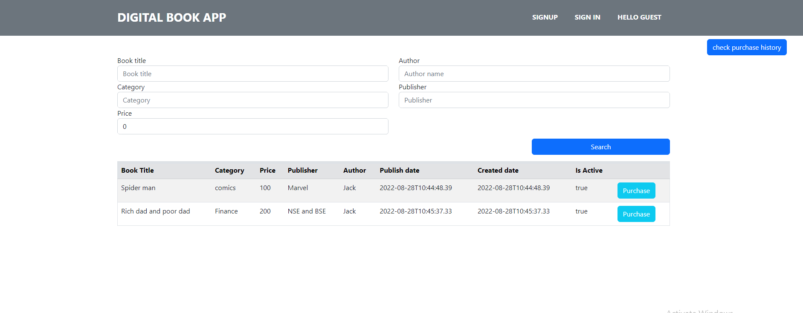
Landing Page
Once the user browse the application, he will be redirected to home screen where he can search for the books he want to read.
From nav bar user can create a account or he can log in if he is already a user.

Slide 3
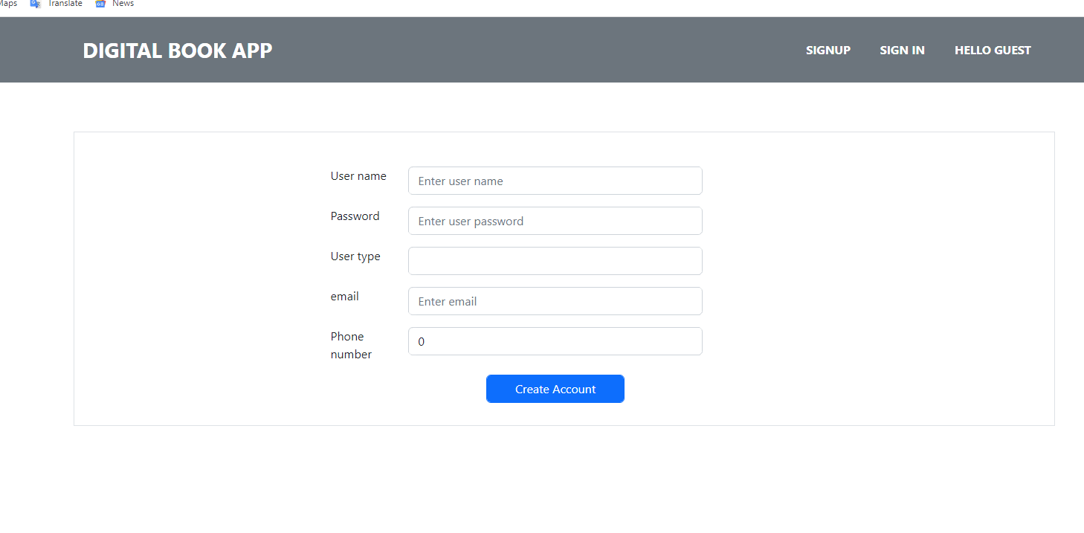
Sign up page
When user click on the sign up he will be directed to create-account component.
By providing valid input he can create his account. Once the successful creation of the account he will be navigated to login screen to sign in for further action.
Important: User should select user type whether he want to create account as Author or reader.

Slide 4
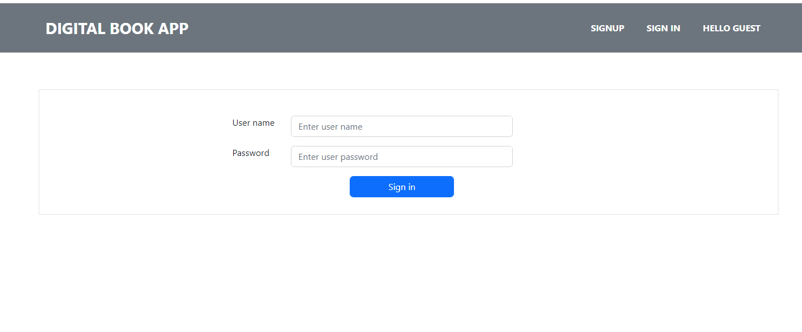
Sign in page
User can log in to his account by providing valid username password and user type.
On successful login he will be routed to home page. Where he can do the action based on his rights.
A token will be generated on successful login and used thought the application whenever its is required

Slide 5
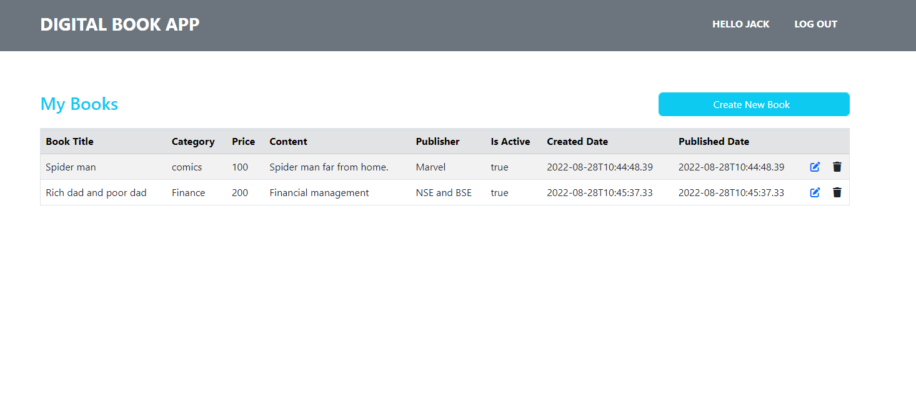
Author login
Once we login as author he will be routed to author home page and set of books will be displayed which is created by him.
He can also create and delete book.
One person login his name will be shown on navbar.
Logout option is given to logout from the application

Slide 6
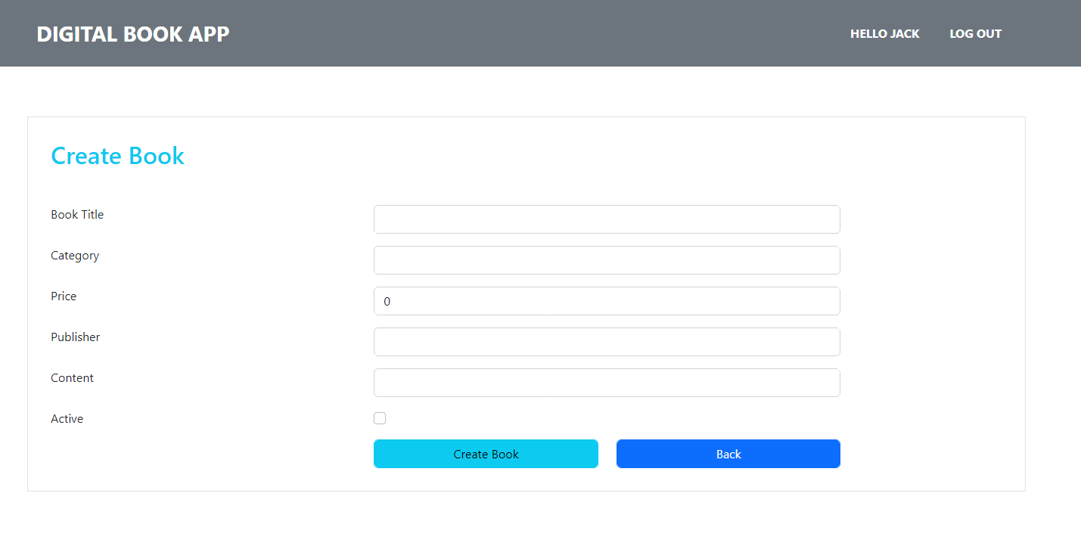
Author login
Author can create book by clicking on create book button. He will be routed to create book page once he clicks on create book button.
Once providing the valid input by clicking on create book it will create book and take him to book list screen.
Back button is to take the author back to list screen.

Slide 7
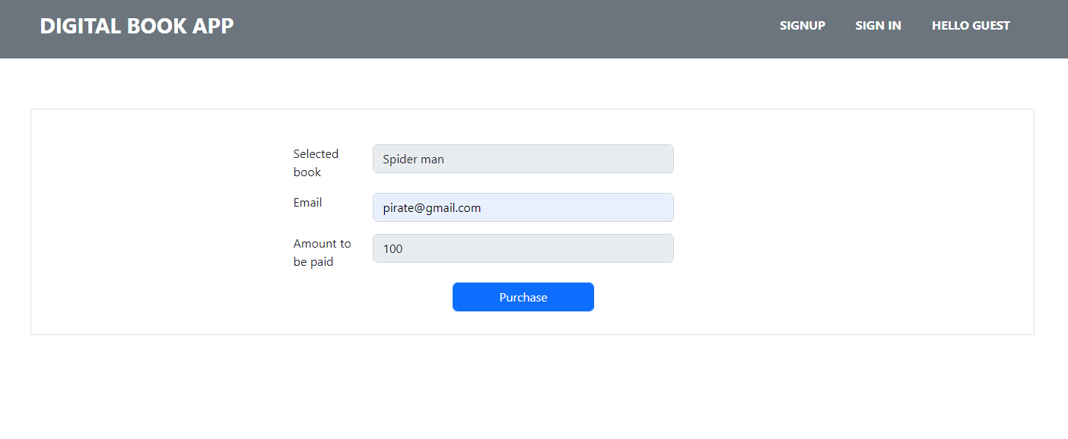
Purchase
Reader can purchase book by selecting the book in landing page.
Email Id is mandatory to purchase the book.

Slide 8
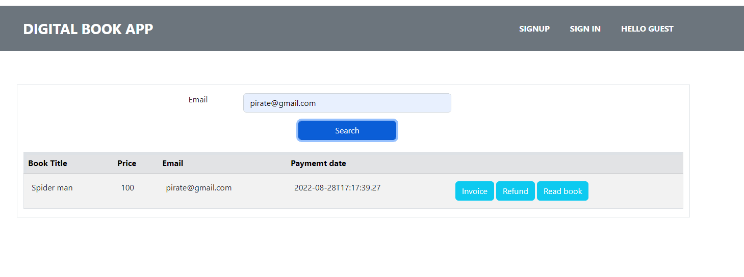
Purchase history
Purchase history can be seen by providing the email id given when purchasing the book.
Invoice can be downloaded.
User can ask fro refund before 24 hours.

